Slide 1

Chapter 1:
Introduction to R Programming for Data Science
Notes:
n

Slide 2
Getting Data into R 4

Slide 3
Objective
Read CSV files, Excel files, and built-in datasets using the R programming language
Read in a text file using the R programming language
Export data from the R programming language into various file formats

Slide 4
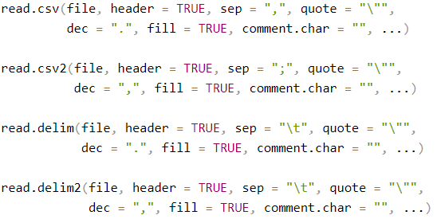
Reading CSV files
CSV files store the data in a table format, and in each row, every column value is separated by a delimiter
Syntax

Slide 5
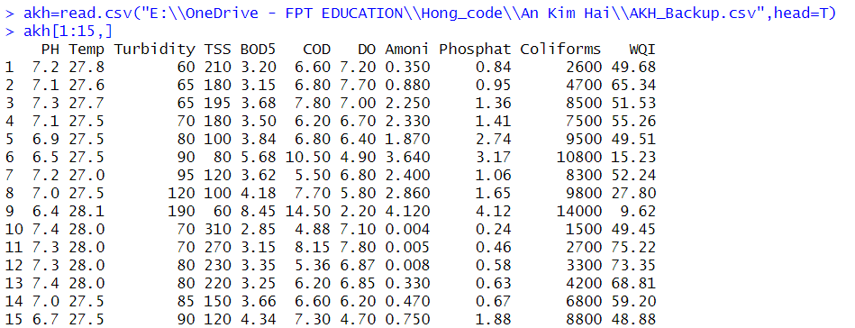
Reading CSV files
Example

Slide 6
Reading Excel files
Install package
Syntax
Usage
read_excel(path, sheet = 1, col_names = TRUE, col_types = NULL, na = "", skip = 0)
Chapter1- Importing Datasets

Slide 7
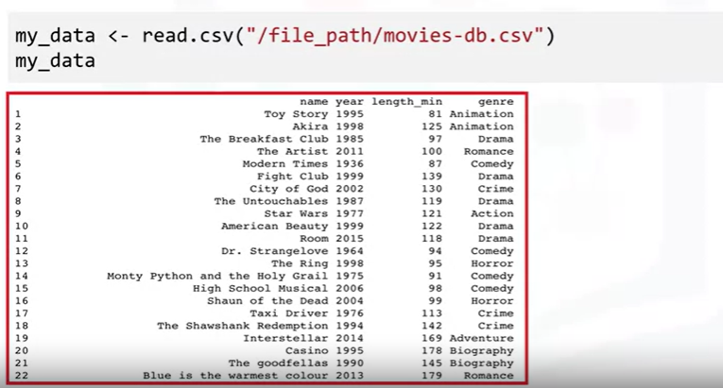
Accessing data from a dataset

Slide 8
Accessing data from a dataset

Slide 9
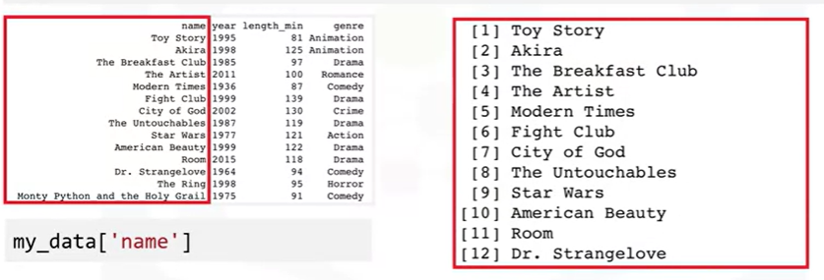
Accessing data from a dataset
Access a column

Slide 10
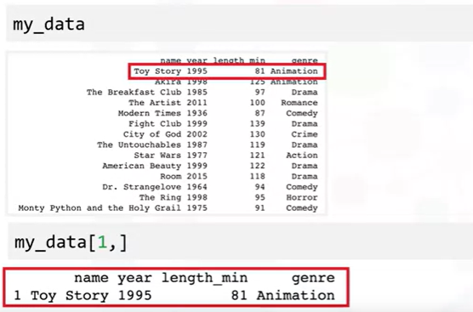
Accessing data from a dataset
Access a row

Slide 11
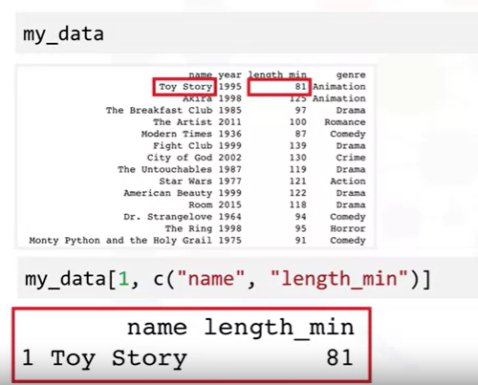
Accessing data from a dataset
Access interested columns of a row

Slide 12
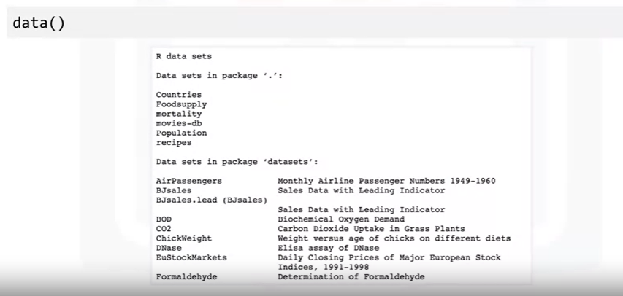
Built-in datasets
R actually provides a number of built-in datasets
To see the available datasets using “data” function.

Slide 13
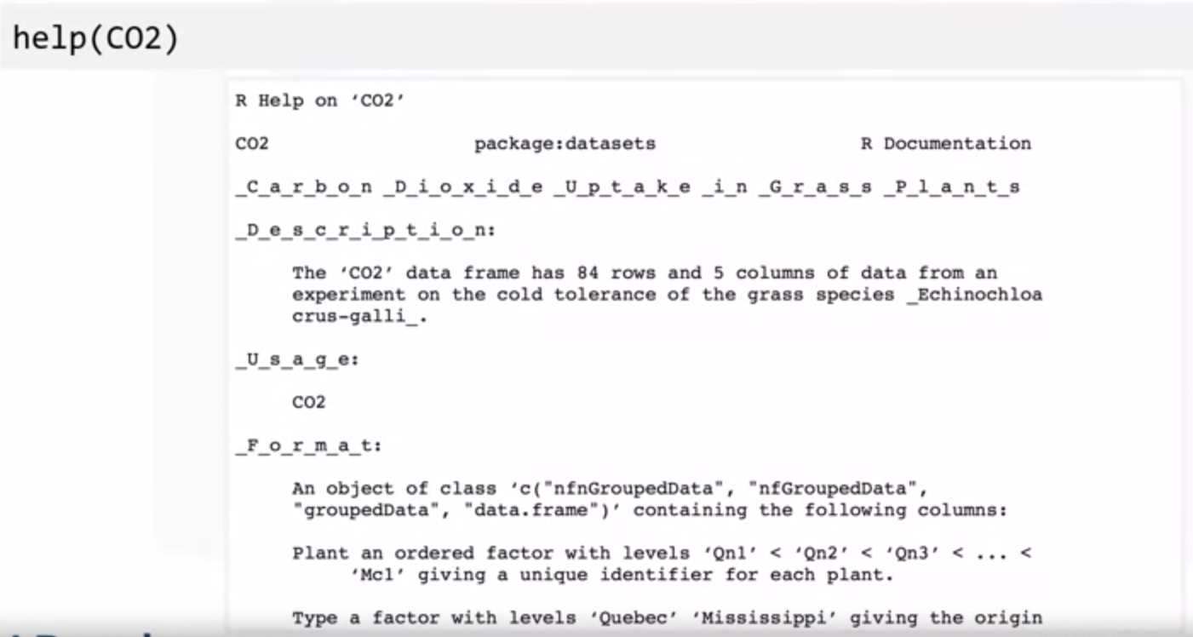
Built-in datasets
R provides documentation for each of the datasets using help function along with the dataset’s name.

Slide 14
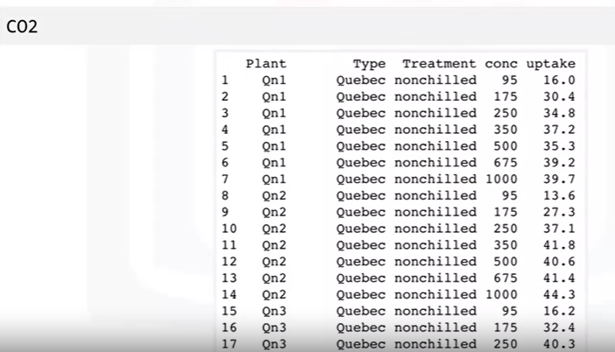
Built-in datasets
With built-in datasets, we don’t need to import it or load it in order to start accessing the data

Slide 15
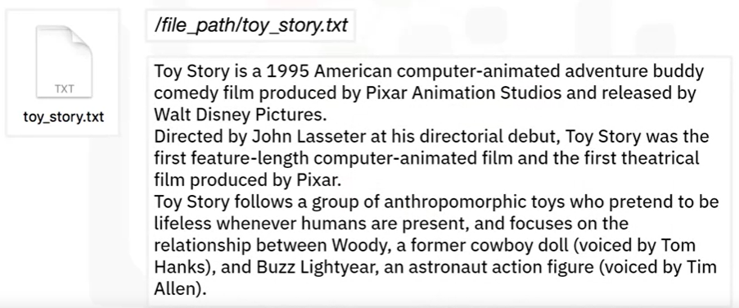
Reading Text Files in R
Consider an example:

Slide 16

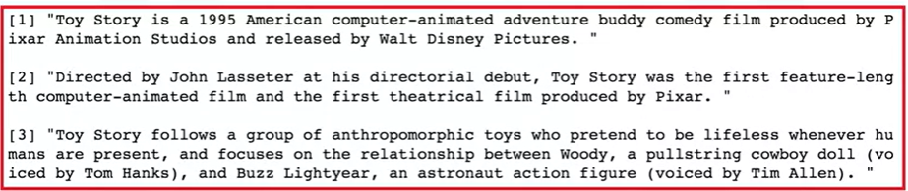

Reading Text Files in R
Read some or all text lines from a connection.
Syntax
Lines are broken up by individual line breaks, which essentially form new paragraphs.
Notes:
Syntax

Slide 17
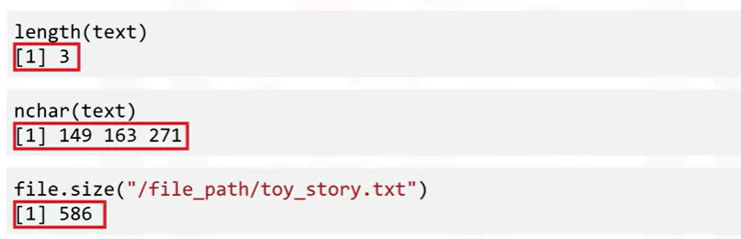
Reading Text Files in R

Slide 18
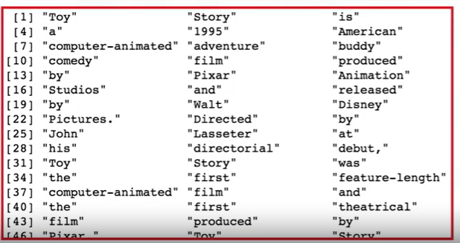
Reading Text Files in R
Scan(): Read data into a vector or list from the console or file. scan function produces a vector with each individual word as an element

Slide 19

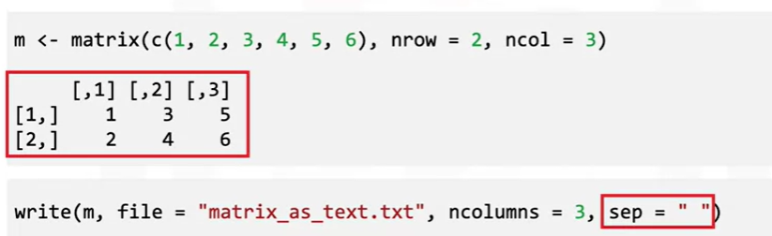
Writing and Saving to Files
Write(): The data (usually a matrix) x are written to file file.
Syntax:
Example:

Slide 20
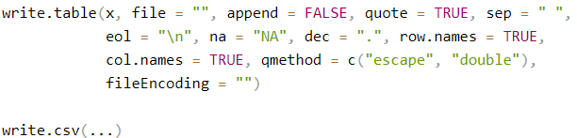
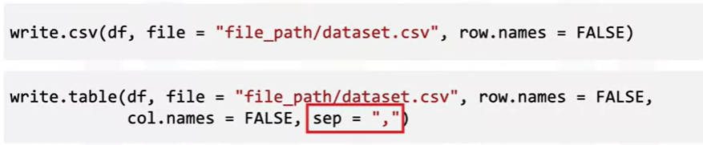
Writing and Saving to Files
write.csv(): Save summaries of partitioned breeding values to CSV files on disk for further analyses of processing with other software or just for saving (backing up) results.
Syntax:
Example:

Slide 21

Writing and Saving to Files
Write.xlsx(): Write a data.frame to an Excel workbook
Syntax:
Example:
write.xlsx( x, file, sheetName = "Sheet1", col.names = TRUE, row.names = TRUE, append = FALSE, showNA = TRUE, password = NULL )

Slide 22
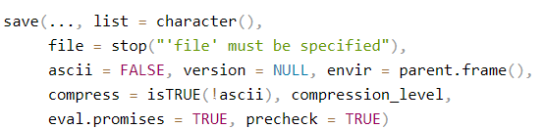
Writing and Saving to Files
save() writes an external representation of R objects to the specified file.
Syntax:

Slide 23
Summary
At this point in the course, you know:
Read a CSV file or an Excel file into a dataset using the read_csv() and read_excel() functions and then access its rows, columns, and individual data points.
The readLines() function reads a text file into a character vector.
The length() and nchar() functions return information about a character vector.
The scan() function reads a text file into a character vector with each individual word as an element.
The write()function exports a dataset as a text file.
The write.csv() and write.table() functions export a dataset as a .csv file.
The write.xlsx() function exports a dataset as an Excel file.
The save() function saves R objects in .RData files.

Slide 24
Q & A

